Slide 1
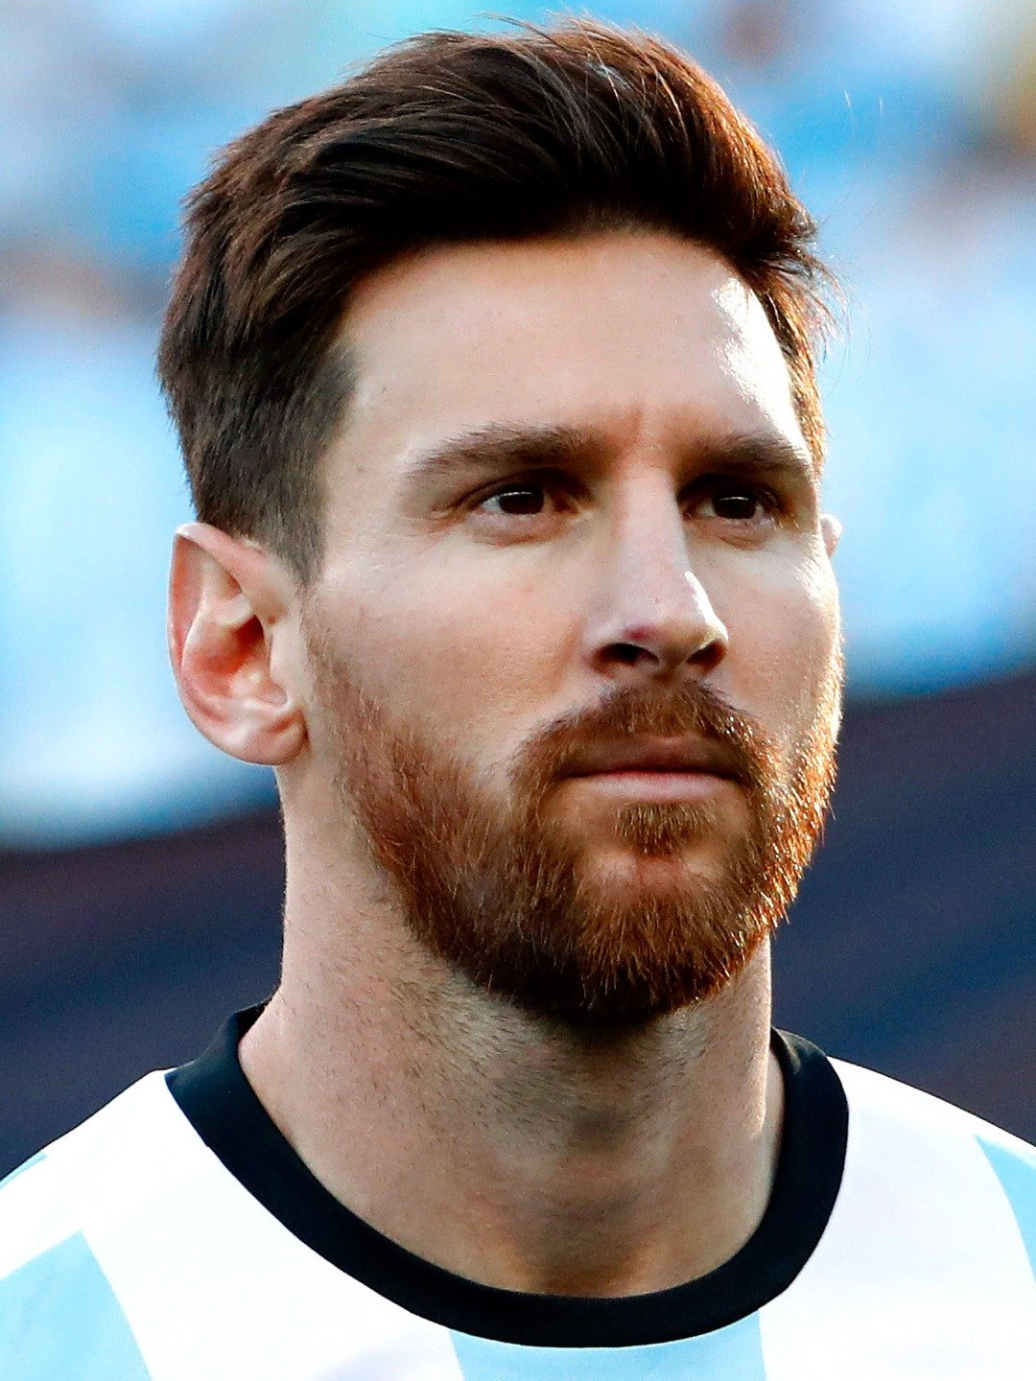
Lionel messi
By JED BAINBRIDGE
Yr 5

Slide 2
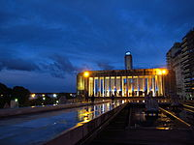
Early life
Born 24 June 1987 Rosario, Argentina
Age 31

Slide 3
Why is he famous
Messi has won a record-tying 5 ballon d’or awards, four of which he won consecutively, and a record 5 European golden shoes

Slide 4
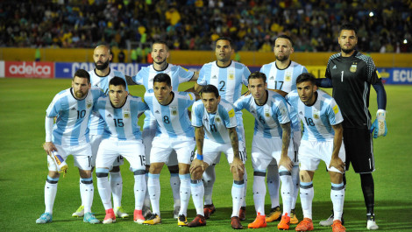
team
MESSI HAS SPENT HIS ENTIRE PROFFESIONAL CAREER WITH BARCELONA, WHERE HE HAS WON 33 TROPHIES, INCLUDING NINE LA LIGA TITLES, FOUR UEFA CHAMPIONS LEAGUE TITLES, AND SIX COPAS DEL RAY. BOTH A PROLIFIC GOALSCORER AND A CREATIVE PLAYMAKER, MESSI HOLDS THE RECORD GOALS SCORED IN LA LIGA WITH 392.

Slide 5
THANK YOU FOR LISTENING!!!!!!!!!!!!!!!!!!!!!!!

Slide 6
Any questions?

